Slide 1
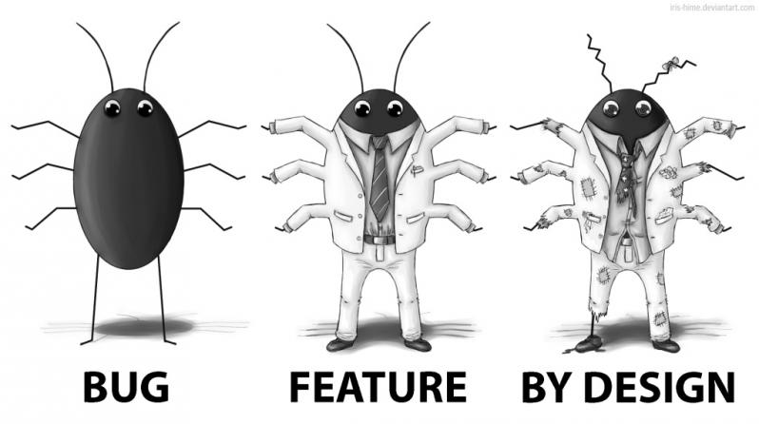
Clinical Decision Support Malfunctions
David Alt, MD, FAAP
October 2018

Slide 2
Objectives
Discuss relevance to informatics professionals
Review published examples
Evaluate firing rate frequency charts
Learn about different malfunctions and how to identify them
Classify CDS malfunctions using a structured taxonomy

Slide 3
Why You Should Care:
The Brigham and Women’s Hospital team surveyed 29 CMIOs:
How often has your site experienced CDSS malfunctions? | N (%)
4 or more times a year | 11 (38%)
1-6 times a year | 8 (28%)
Less than 1 time a year | 8 (28%)
Never | 2 (7%)
How confident are you that your existing processes and procedures are sufficient to prevent or detect all CDSS malfunctions before they reach the user? | N (%)
Totally confident | 0 (0%)
Very confident | 2 (7%)
Somewhat confident | 7 (24%)
Not very confident | 12 (41%)
Not at all confident | 6 (21%)
TLDR:
Most institutions have multiple malfunctions and are
not confident in their ability to detect or prevent them.
(Wright et al, 2016)
Notes:
Wright, A., Hickman, T. T., McEvoy, D., Aaron, S., Ai, A., Andersen, J. M., . . . Bates, D. W. (2016). Analysis of clinical decision support system malfunctions: a case series and survey. J Am Med Inform Assoc, 23(6), 1068-1076. doi:10.1093/jamia/ocw005

Slide 4
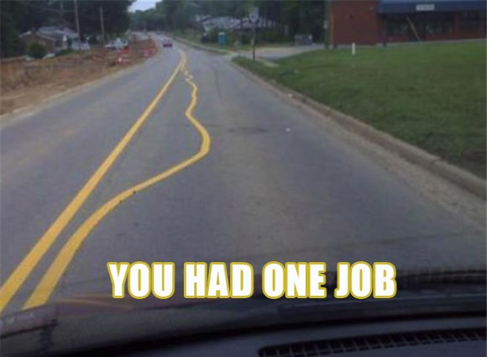
Case 1: Thyroid Function Testing
During a vendor demonstration of medication-lab interactions for Brigham and Women’s Hospital’s EHR, an alert to order thyroid testing for patients on amiodarone failed to fire.
Investigation revealed that the malfunction had been present for over two years.
(Wright et al, 2016)

Slide 5
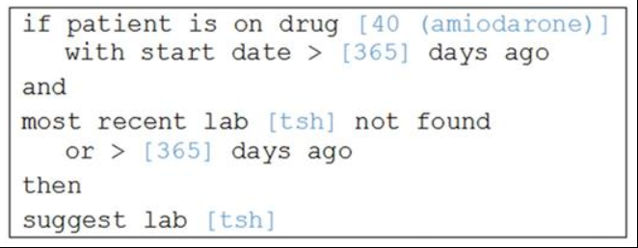
Case 1: Thyroid Function Testing Alert Rule
Data Elements:
medication name
medication code
lab name
time interval
“If the patient has been on amiodarone for more than a year,
and hasn’t had a TSH in the past year,
suggest ordering TSH.”
(Wright et al, 2016)

Slide 6
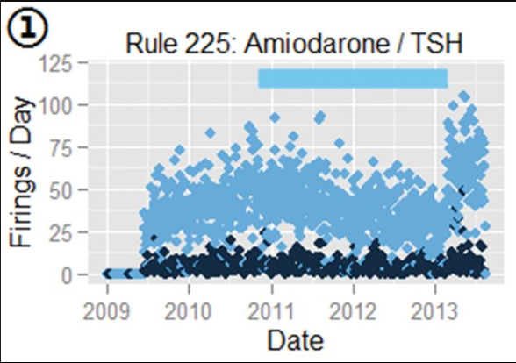
Case 1: Alert Frequency Analysis
What pattern do you see?
Subtle decrease in firing rate,
then abrupt increase
Light blue dots: weekdays
Dark blue dots: weekends
Blue bar: period of malfunction
(Wright et al, 2016)

Slide 7
Case 1: Sequence of Events
11/2009: EHR update
Amiodarone ID code changed to 7099
11/2010: Firing rate starts declining
Effect delayed by one year due to rule conditions
Continues to fire for patients started on amiodarone before the change
01/2013: Firing rate abruptly climbs
Rule updated to detect both: 40 or 70991
(Wright et al, 2016)

Slide 8
FINAL ANALYSIS
Functioning as designed.
Every system is perfectly designed to get the results it gets.
Inspired, the team at BWH looked at their other alerts ...

Slide 9
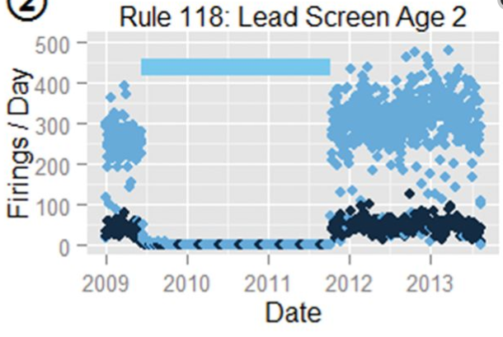
Case 2: Lead Screening for 2 Year Olds
Rule
If patient 23 – 29 months old,
and no lead results w/in 6 months,
suggest lead testing.
Pattern
(Wright et al, 2016)

Slide 10
Case 2: Pattern Analysis
What’s happening here?
Firing rate slows in 2009
Rule stops firing completely
Two years later, the rule abruptly resumes
Similar alerts for 1, 3, and 4 year olds were unaffected
(Wright et al, 2016)

Slide 11
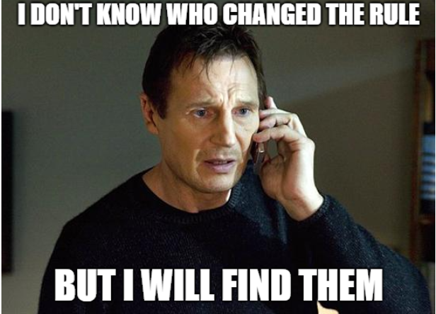
Case 2: Root Cause Analysis
No rule, code, or method changes were documented in the change log
An audit log showed several changes, but didn’t detail the changes
System backup tapes from long-term storage showed two incomplete clauses added to the alert trigger and later removed
The rule engine could not process the incomplete criteria, causing the rule to fail
Estimated missed alerts: 176,708 alerts over 850 days
(Wright et al, 2016)
Notes:
1. The EHR developer team maintained a separate database to log all changes to the decision support rules. This change log was separate from the rule editing environment and all changes had to be manually documented.
2. The audit log was automatic, and logged that changes occurred, but not what they were or who changed them.
3. System backup tapes with slices before and after each change in the frequency were reviewed and revealed the actual changes: clauses checking for gender and smoking status. Rule definitions must include all possible values for each criterion (e.g., for gender, can accept M, F, unknown, etc); however, the two clauses did not specify possible values for the engine to match against. Thus, the rule could never successfully reach the firing threshold.
The changes to the rule were never documented by the developer in the manual base; neither when first included (presumedly unintentionally), nor several years later, when they were removed.

Slide 12
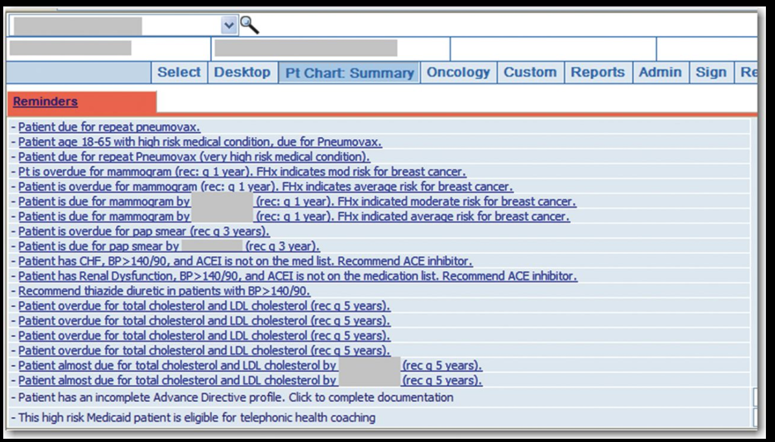
Other Examples
A mistake in an external drug classification system led to suggestions that anti-platelet drugs be given to patients already taking one
An EHR upgrade “caused numerous spurious alerts to fire”
... like the need for regular Pap smears on a 2 month old boy
(Wright et al, 2016)
Notes:
The “spurious alerts” anomaly was noticed almost immediately and reported by dozens of users as thousands of inappropriate alerts started triggering abruptly.

Slide 13
A Taxonomy of CDS Malfunctions
As with all complicated systemic problems, a systematic approach is needed if we want to make any progress.
Cause of malfunction
Mode of malfunction discovery
When malfunction began (high risk events for CDS malfunction)
How malfunction affected rule firing
(Wright et al, 2018)
Notes:
Wright, A., Ai, A., Ash, J., Wiesen, J. F., Hickman, T. T., Aaron, S., . . . Sittig, D. F. (2018). Clinical decision support alert malfunctions: analysis and empirically derived taxonomy. J Am Med Inform Assoc, 25(5), 496-506. doi:10.1093/jamia/ocx106

Slide 14
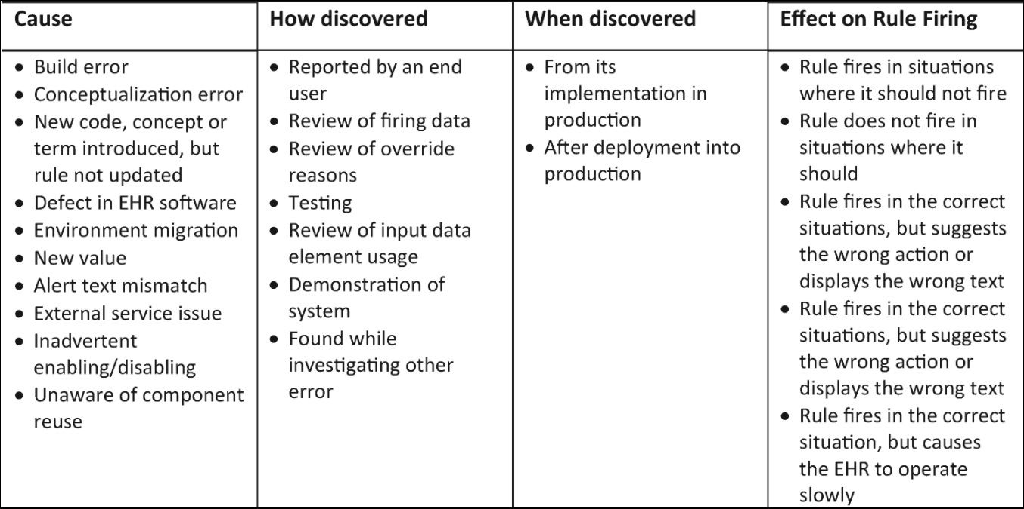
Taxonomy Overview
(Wright et al, 2018)

Slide 15
Causes of Malfunctions
Cause | Description
Build error (21%) | Properly designed, but wrongly implemented
Conceptualization error (16%) | Wrongly designed, and implemented that way
New code/concept w/o rule update (15%) | Underlying code set changed, but rule wasn’t updated
Defect in EHR (15%) | Programming error causes EHR not to function as expected
Environment migration (10%) | Malfunction from moving rules between environments
N=68
New value (9%) | Set of allowed values for a concept changes
External service issue (6%) | External service fails or can’t be reached, affecting CDS
Alert text mismatch (4%) | Displayed text doesn’t match underlying logic
Inadvertent enabling/disabling (3%) | Rule in production inappropriately toggled
Unaware of component reuse (1%) | Code block used in multiple rules is changed, affecting all
(Wright et al, 2018)
Notes:
Build error: designed to fire for inhaled fluticasone, but implementation doesn’t check route
Conceptualization error: supposed to fire for all depressed patients, but SME only gives codes for MDD. Can be that the rule designer failed to consider an issue, or considered it but didn’t record it in the rule specification.
New code, concept, or term introduced, but rule not updated: amiodarone/thyroid testing case
Defect in EHR software: EHR has code to import rules, but a bug in the importing module scrambles the diagnosis codes
Environment migration: a rule currently under development is accidentally moved to production as part of an otherwise tested package; OR, the CDS rules are migrated to production, but the laboratory codeset is not
New value: unit used internally for weight changes from pounds to kg, affecting rules that use weight in calculations
External service issue: bilirubin CDS using Bilitool fails when Bilitool server is down
Alert text mismatch: Alert states “Patient has CAD on problem list and a beta blocker is not on the medication list. Recommend beta blocker.” However, logic is firing because CAD is on the (historical) medical history.
Inadvertent enabling/disabling: a seasonal influenza alert is mistakenly enabled in the summer.
Unaware of component reuse: a coded set that defines diabetes is changed to fix an issue in one rule, but all rules using it are affected, unbeknownst to the developer

Slide 16
Mode of Malfunction Discovery
Mode of discovery (n=68) | Description
Reported by end user (54%) | User notifies help desk, files a safety report, etc
Review of firing data (25%) | Retrospective examination of alert firing logs reveals anomalies
Review of overrides (7%) | Retrospective examination of user-entered override reasons was conducted
Testing (7%) | Direct testing revealed malfunction
Review of input data element usage (3%) | Changes in pattern of use of data elements that are used by the rule logic were reviewed (e.g., orderables)
Demonstration of system (1%) | Error revealed while demonstrating how the system worked
Found while investigating another error (1%) | Malfunction incidentally found while investigating another rule error
(Wright et al, 2018)
Notes:
End user: user calls the help desk because mammograms are recommended for a baby boy
Firing data: data analyst notices an alert stopped firing over the past month
Overrides: Researcher notices that alert suggesting insulin for ER patients is frequently overridden with comments like “patient already received insulin”; investigation reveals a logic error that causes the alert to miss prior insulin administrations
Testing: analyst testing in prod before go-live notices a sepsis alert isn’t firing when it should
Input data element usage: analyst observes a new code being used for TSH results at one site in an integrated system, AND knows that a drug monitoring alert depends on TSH results, and the rule hasn’t been updated to include the new lab result code
Demonstration: vendor demonstrating an interaction-monitoring system doesn’t fire
Incidental find: knowledge engineer investigating a particular CDS problem incidentally observes that an alert related to renal dose adjustment is also not firing correctly

Slide 17
When Malfunction Began (high risk events)
Initiation (n=68) | Description
At time of implementation (in production) (54%) | Rule never fired correctly in production
After deployment (in production) (46%) | Rule initially worked, but failed at some point
Alternately, during ...
Design
Implementation
At Deployment
After Deployment
High-risk events:
rule design/implementation
system upgrades/software updates (either EHR or related clinical information systems)
changes to the rules or underlying code sets
environment migration (e.g., dev → test → prod)
(Wright et al, 2018)

Slide 18
How Malfunction Affected Rule Firing
Effect | Description
False positive (49%) | Rule fires when it isn’t supposed to
False negative (26%) | Rule doesn’t fire when it is supposed to
Wrong information (21%) | Rule fires correctly, but offers inappropriate information or actions
System slowdown (4%) | Rule fires correctly, but causes the EHR to slow down
(Wright et al, 2018)
Notes:
“Rule fires in situations where it should not”
“Rule does not fire in situations where it should”
“Rule fires in the correct situations, but suggests the wrong action or displays the wrong text”: A rule that suggests adding sickle cell disease to the problem list is able to be overridden if the patient does not have sickle cell disease. Due to an issue with rule configuration, the acknowledgment reason offered is “Patient does not have gestational diabetes” rather than “Patient does not have problem.”
“Rule fires in the correct situation, but causes the EHR to operate slowly”: rule might have inefficient logic that fetches too much data, or depends on an external service that is slow

Slide 19
Classifying Our Case Studies ...
 | Case 1: Thyroid Tests | Case 2: Lead Screening | Pap Smears for Babies
Cause | Rule not updated with new medication code | Rule unintentionally edited | Unintended effect from unrelated programming
Mode of discovery | Accidental (noticed at demo) | Screening via firing rate analysis | User reports
When malfunction began | Code set updated | Rule edited | System upgrade
Effect on rule firing | Subtly declined | Abruptly stopped | >10-fold increase

Slide 20
Ways to Identify CDS Malfunctions
“Current approaches for preventing and detecting such malfunctions are inadequate.”
Ask your users!
Over half of all malfunctions are spotted by end users
Other stakeholders include: rule designers (SMEs), CDS developers, CMIOs
Analyze your data (firing rates, override reasons)
Data analysis revealed a third of all malfunctions
Be alert during high risk events
Test CDS rules before and after every upgrade
Yield is lower, but is one of the few proactive approaches you can take

Slide 21
Identifying CDS Malfunctions: OHSU Experience
OHSU examined firing rate anomalies over a 5 year period (Epic)
Rates deviating from historical or expected trends flagged for analysis
Methods: “Expert visualization” and “SPC (Statistical Process Control) methods”
Results: 21 anomalies
4 malfunctions (not functioning as designed or expected)
8 false positives (fired when it shouldn’t have)
9 unclassified (insufficient information to determine cause of anomaly)
Conclusions:
“Expert visualization is a robust method of detection, but resource-intensive.”
“SPC-based methods, when applicable, perform reasonably well retrospectively.”
(Kassakian, 2016)
Notes:
Kassakian, S. Z. (2016). Clinical Decision Support Malfunctions. (MS), Oregon Health & Science University, OHSU.
Finding them:
154 were identified by statistical methods (sens 95%, PPV 29%, F-measure 0.44)
"Expert visualization is a robust method of detection, but resource intensive." - basically plotting alert rates on a chart against expected alert rates and eyeballing for deviations. Ex: you expect a spike for influenza in flu season but don't see it
"SPC-based methods, when applicable, perform reasonably well retrospectively."
- had different thresholds for various standard deviations, e.g. would only need one occurrence if > 3SD but might need 2-3 if it's 2-3 SD range

Slide 22
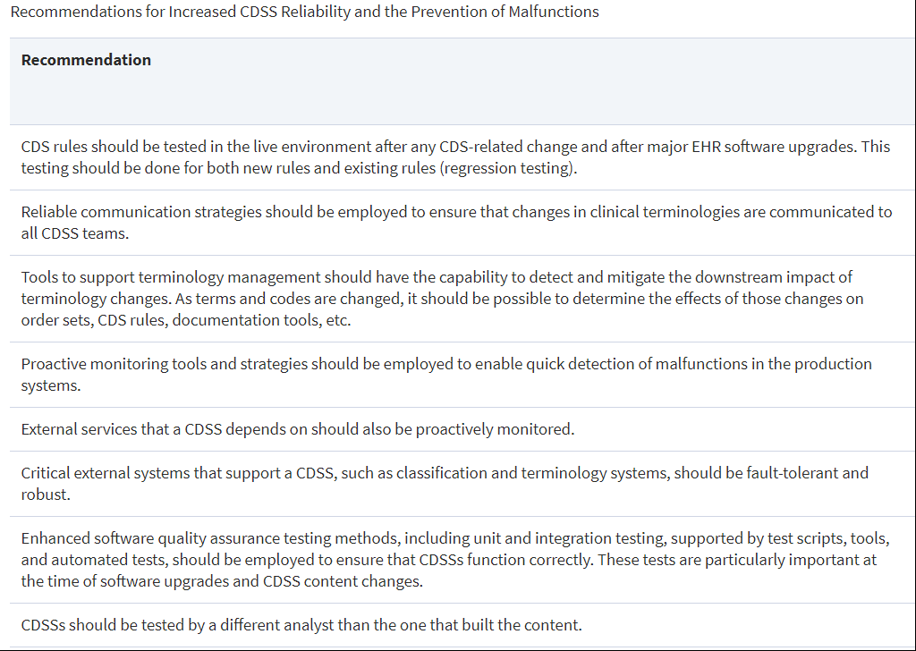
Improving CDSS Reliability
(Wright et al, 2018)

Slide 23
Fellow Opportunities
Clinical
Identify alert malfunctions in your system, then investigate the clinical and financial costs
Lead screening example: how many children weren’t screened that should have been?
Technical
Develop a novel method to identify CDS malfunctions
Administrative
Review (or develop, as needed) your organization’s CDS rule maintenance process
How are rules designed, created, tested, and maintained?
Are they tested before and after every upgrade?
How often are old rules re-tested, if at all?
Does anyone other than the software developer test the rules?
Once an error is identified, what is the process to address it?
Are there any barriers to that process that could affect clinical care?
Notes:
Research/Project Opportunities
Clinical: Identify alert malfunctions in your system, then investigate clinical and financial costs (e.g., with the lead screening, how many children actually weren't screened that should have been during the malfunction period?)
Technical: Develop a novel method to identify CDS malfunctions
Administrative: review (or develop, as needed) your organization's CDS rule maintenance process
how are rules designed, created, maintained, and tested? Are they tested before and after every upgrade? How often are old rules re-tested, if at all?
once an error is identified, what is the process to address it, and are there any barriers to that process that could affect clinical care?
does anyone other than the software developer test the rules?

Slide 24
References
Ash, J. S., Sittig, D. F., Campbell, E. M., Guappone, K. P., & Dykstra, R. H. (2007). Some Unintended Consequences of Clinical Decision Support Systems. Paper presented at the AMIA 2007 Symposium.
Hussain, M., Hassan, A. U., Sadiq, M., Kang, B. H., & Lee, S. (2018). Missing Information Prediction in Ripple Down Rule Based Clinical Decision Support System. Paper presented at the International Conference on Smart Homes and Health Telematics.
Kassakian, S. Z. (2016). Clinical Decision Support Malfunctions. (MS), Oregon Health & Science University, OHSU.
Wright, A., Ai, A., Ash, J., Wiesen, J. F., Hickman, T. T., Aaron, S., . . . Sittig, D. F. (2018). Clinical decision support alert malfunctions: analysis and empirically derived taxonomy. J Am Med Inform Assoc, 25(5), 496-506. doi:10.1093/jamia/ocx106
Wright, A., Hickman, T. T., McEvoy, D., Aaron, S., Ai, A., Andersen, J. M., . . . Bates, D. W. (2016). Analysis of clinical decision support system malfunctions: a case series and survey. J Am Med Inform Assoc, 23(6), 1068-1076. doi:10.1093/jamia/ocw005

Slide 25
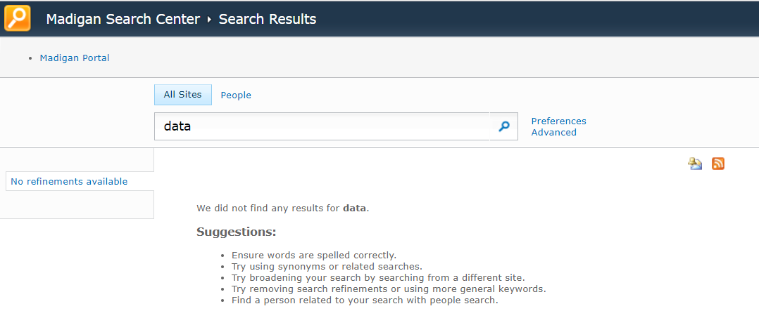
BONUS ROUND
Can you find Madigan’s data?
Notes:
“SharePoint” is not an acceptable answer!

Slide 26
And Finally, A Quick Review ...

Slide 27
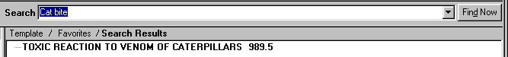
The Five Rights of Clinical Decision Support
THE RIGHT INFORMATION ...
Yes, that’s exactly what I was looking for.

Slide 28
The Five Rights of Clinical Decision Support
THE RIGHT PERSON ...
Who’s doing what to whom now?

Slide 29
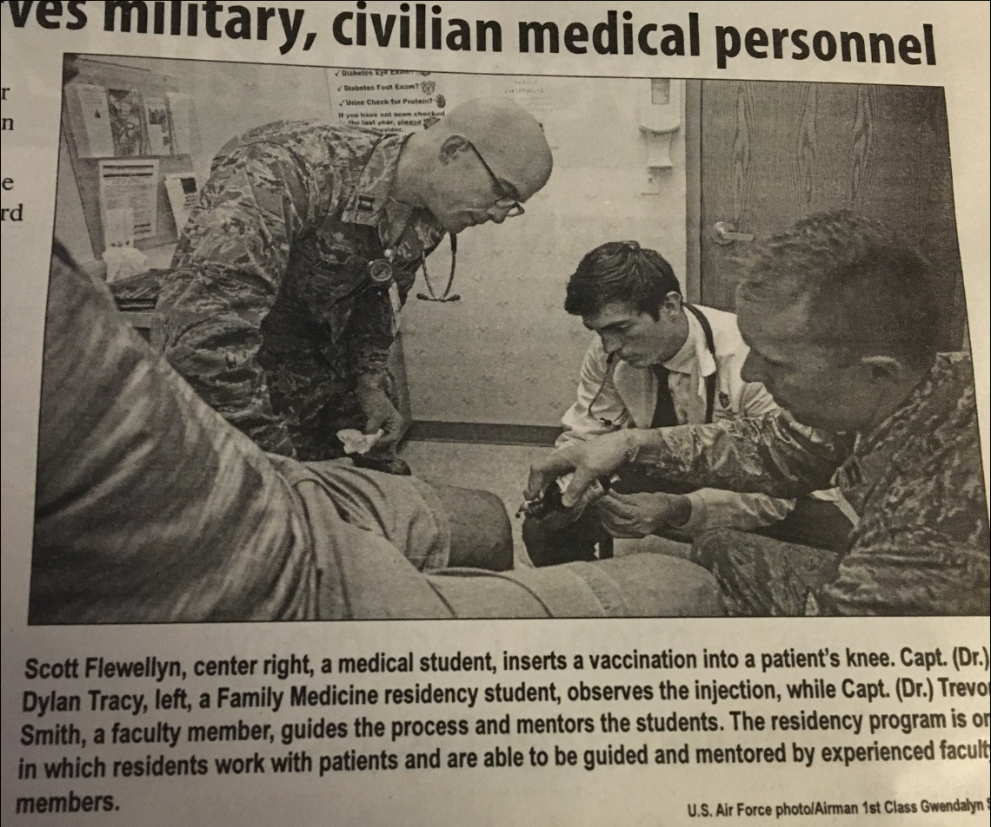
The Five Rights of Clinical Decision Support
THE RIGHT
INTERVENTION ...
No wonder people don’t trust vaccines.

Slide 30
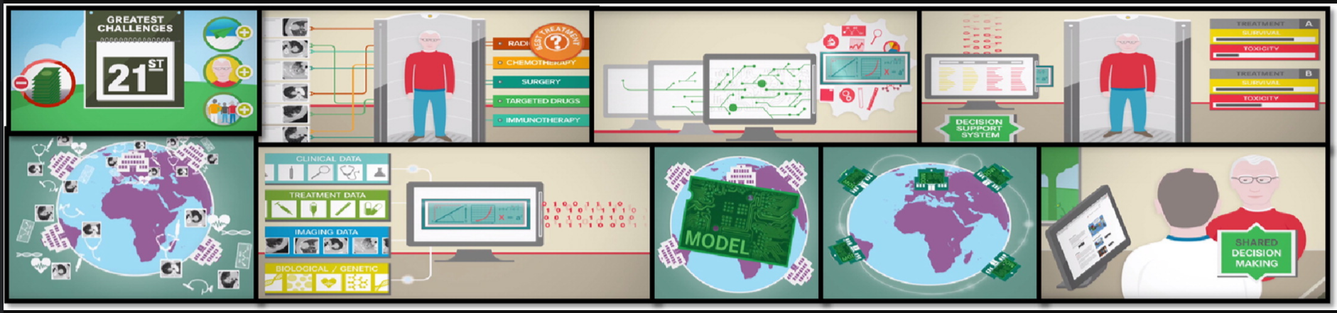
The Five Rights of Clinical Decision Support
THE RIGHT CHANNEL ...
Picture abstract for: “Decision support systems for personalized and participative radiation oncology”
Is this really appropriate for your audience?
Notes:
Picture abstract for: “Decision support systems for personalized and participative radiation oncology”

Slide 31
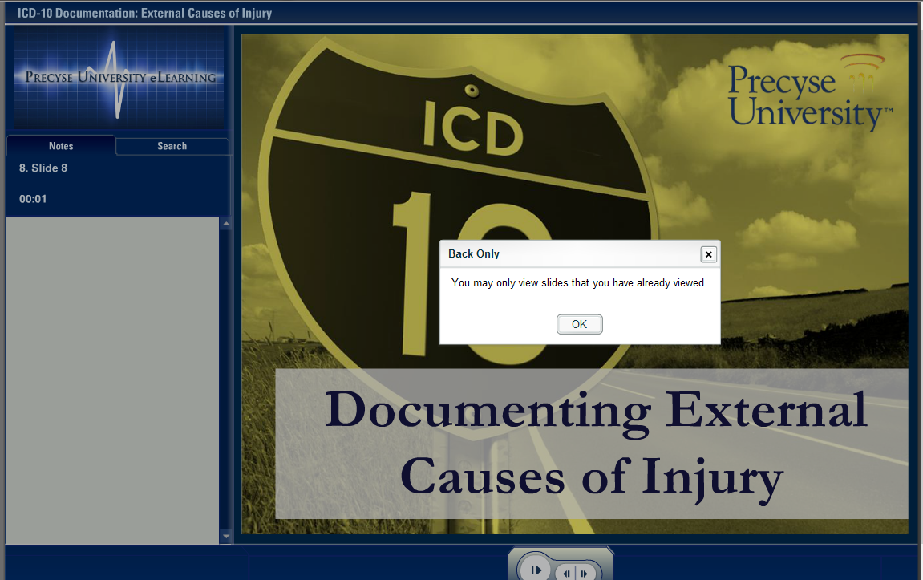
The Five Rights of Clinical Decision Support
THE RIGHT
TIME IN THE
WORKFLOW ...

